Slide 1



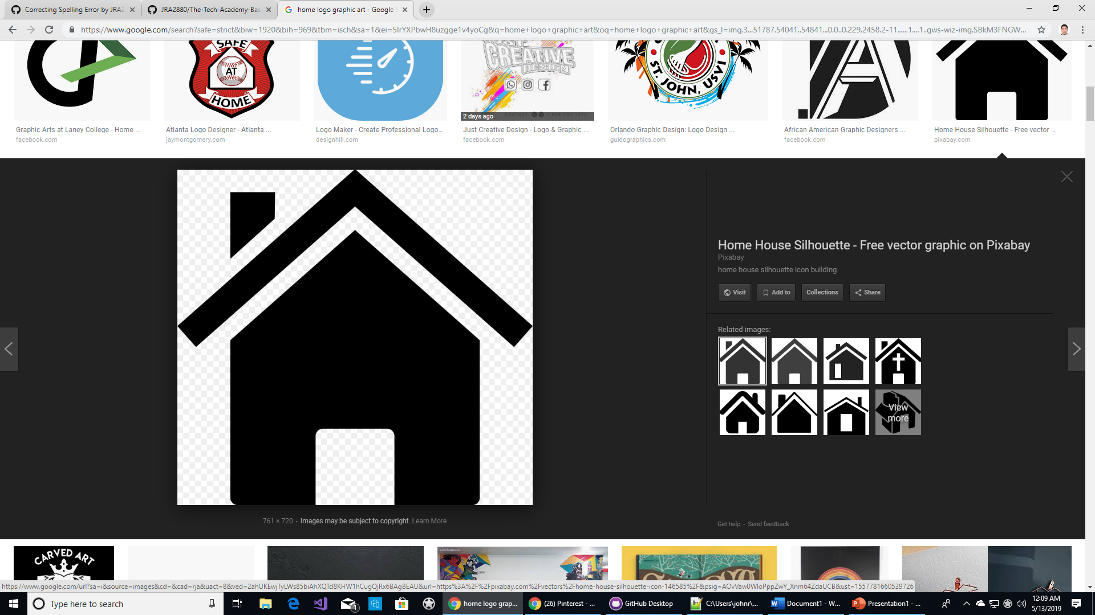




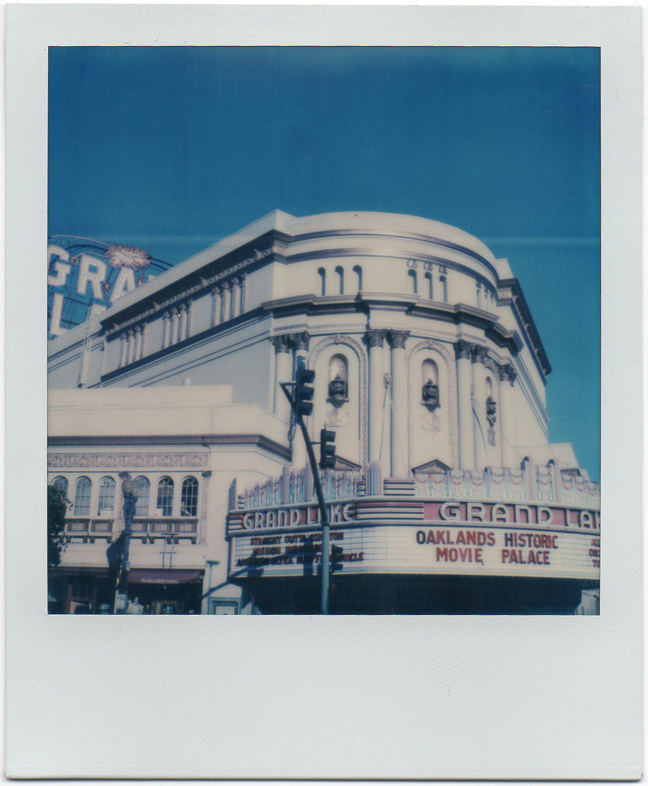
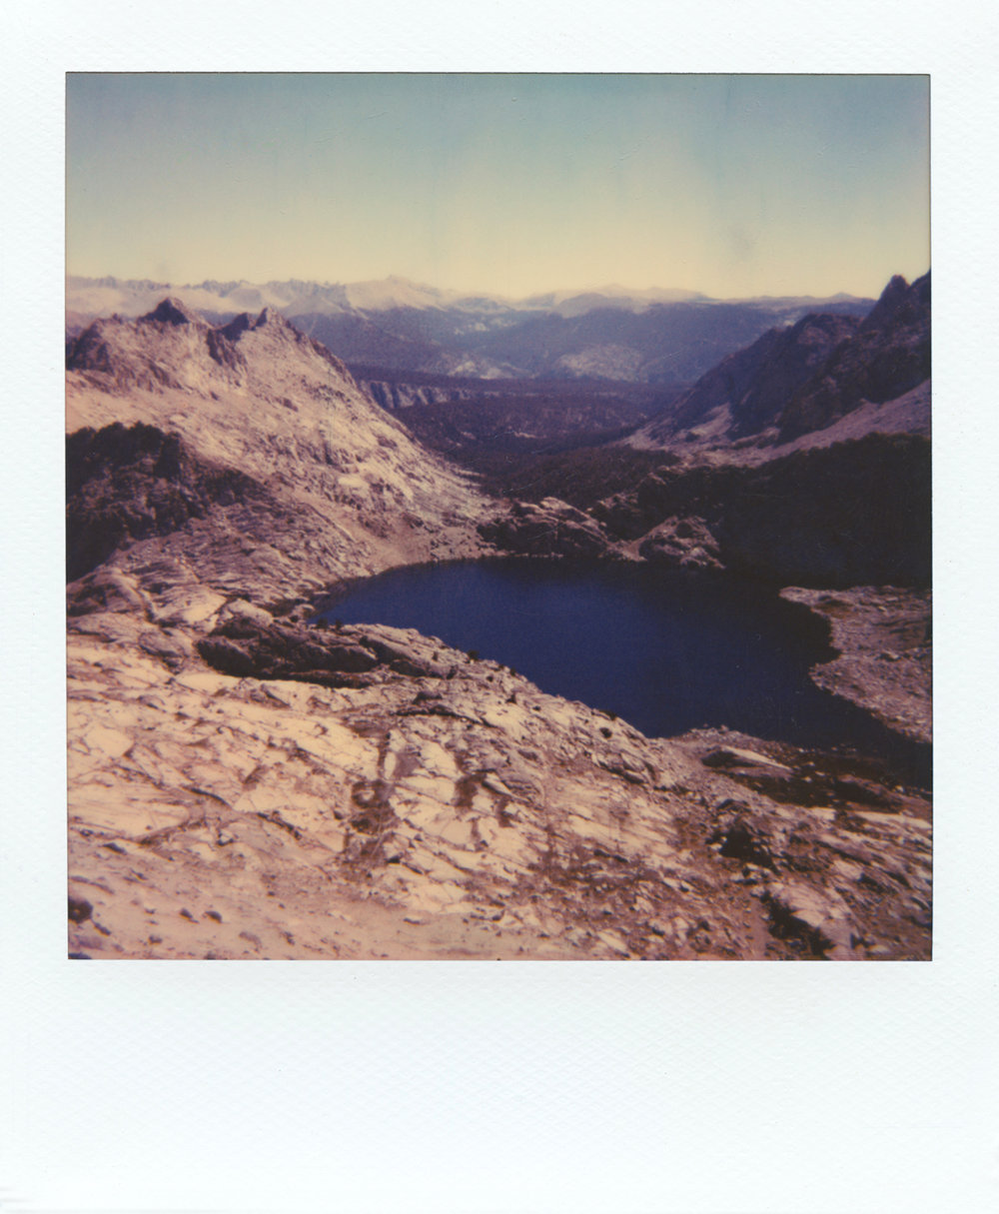
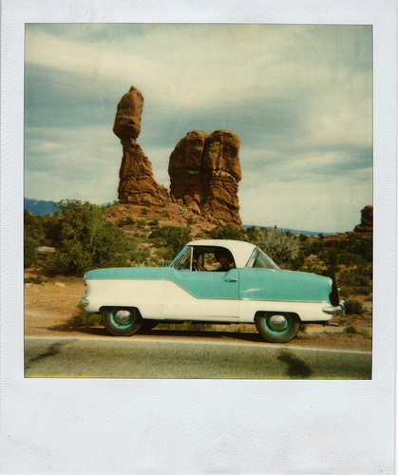
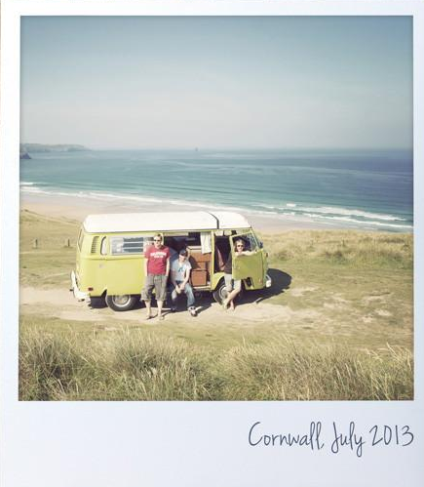
Polaroid Photo
Sign in
The internet’s only original polaroid collage!
Home
Sports
Space
Wildlife
Plants
History
“The days, months, and years eventually reveal, like a Polaroid, a clear picture of how significant events and decisions ultimately shape our lives.”
~Hoda Kotb, American Journalist~
Polaroid Photo is the original online polaroid database where you can view polaroid photos and upload your own polaroid photos. Build your own collage today!
To be able to view through the polaroid collection, please create an account.
Create an Account
First Name:
Last Name:
E-mail address:
www.polaroidphoto.com | C 2019

Slide 2


Polaroid Photo Web Page Design
Home Page
Home Page Elements
Graphic NAV Bar
Aside element with asynchronous quote and pictures
Main paragraph
Account creation form
Sports
Space
Wildlife
Plants
History
Graphic NAV Bar
Aside element with asynchronous quote and pictures
Create collage form
Graphic NAV Bar
Aside element with asynchronous quote and pictures
Create collage form
Graphic NAV Bar
Aside element with asynchronous quote and pictures
Create collage form
Graphic NAV Bar
Aside element with asynchronous quote and pictures
Create collage form
Graphic NAV Bar
Aside element with asynchronous quote and pictures
Create collage form

